Slide 1

social emotional competence
Apss 1L01 Group 6:
Jiang guanlin,
tsz kwan Cheung,
chun yung deng,
Jason Kenneth hiu,
wan yuet lam,
ting shek so

Slide 2

Part 1 --- Story about social emotional competence

Slide 3
Social-Emotional Competence (Academic Definition)
“Social competence refers to the ability to engage in meaningful interactions with others”(Junge et al., 2020, p. 1). “Emotional intelligence is the ability to perceive emotions, to access and generate emotions so as to assist thought, to understand emotions and emotional knowledge, and to reflectively regulate emotions so as to promote emotional and intellectual growth” (Mayer & Salovey, 1990, para. 10).

Slide 4
Social-Emotional Competence (Academic Definition)
“Social Competence is an ever-changing system, which consists of social motifs and social abilities and has the function to organize social behavior, and to trigger the operation of the individual elements of the system. Social competence has traditionally been defined as the complex system of social abilities, habits, skills and knowledge. Emotional competence comprises three basic components. They are (a) the expression of emotions, (b) the understanding of emotions and (c) the experience of emotions” (Zsolnai, 2015, p. 2)

Slide 5
Social-Emotional Competence (Academic Definition)
“Social and emotional competence is the ability to interact with others, regulate one’s own emotions and behavior, solve problems, and communicate effectively” (virtual lab school, n.d., Para. 7).

Slide 6
Similarities and differences?
Similarities:
The skills that have good communication with others
The emotion and behavior control and understanding
Differences:
First one mention that the meaningful communication ability
Second one mention the knowledge and emotion experience

Slide 7
OWN GROUP DEFEFINATION
Solving problem skills
Manage their own emotion and behavior, also can
Have high communication effective to other people
(application in speaking, playing, or working with others)

Slide 8
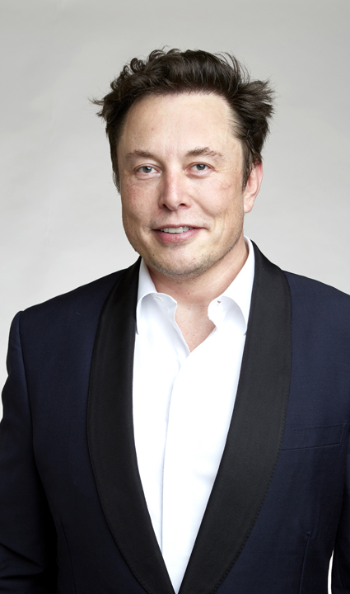
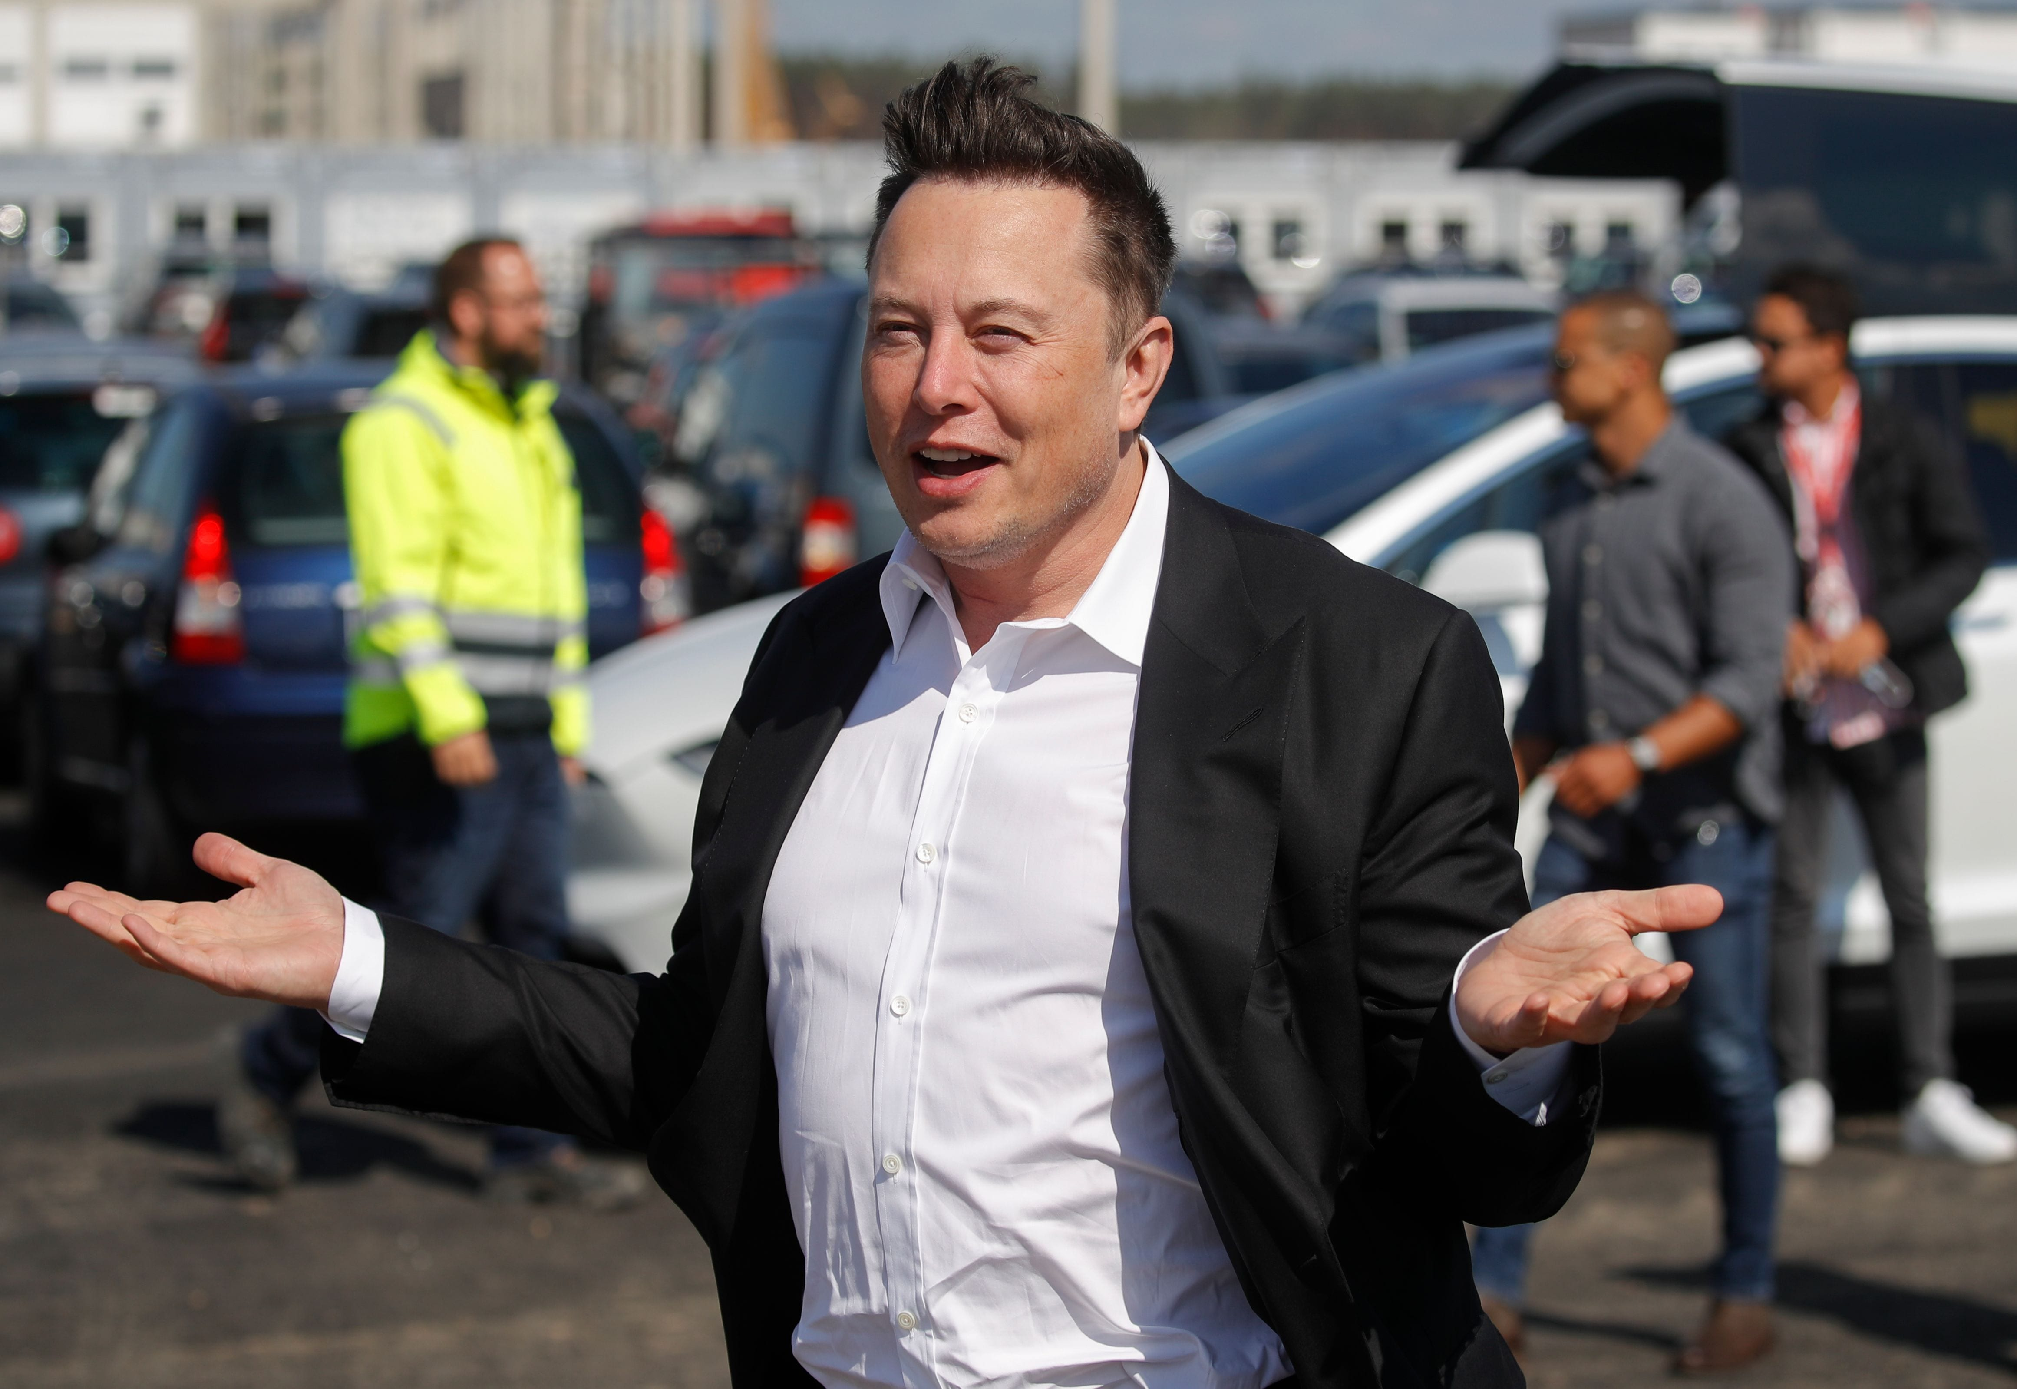


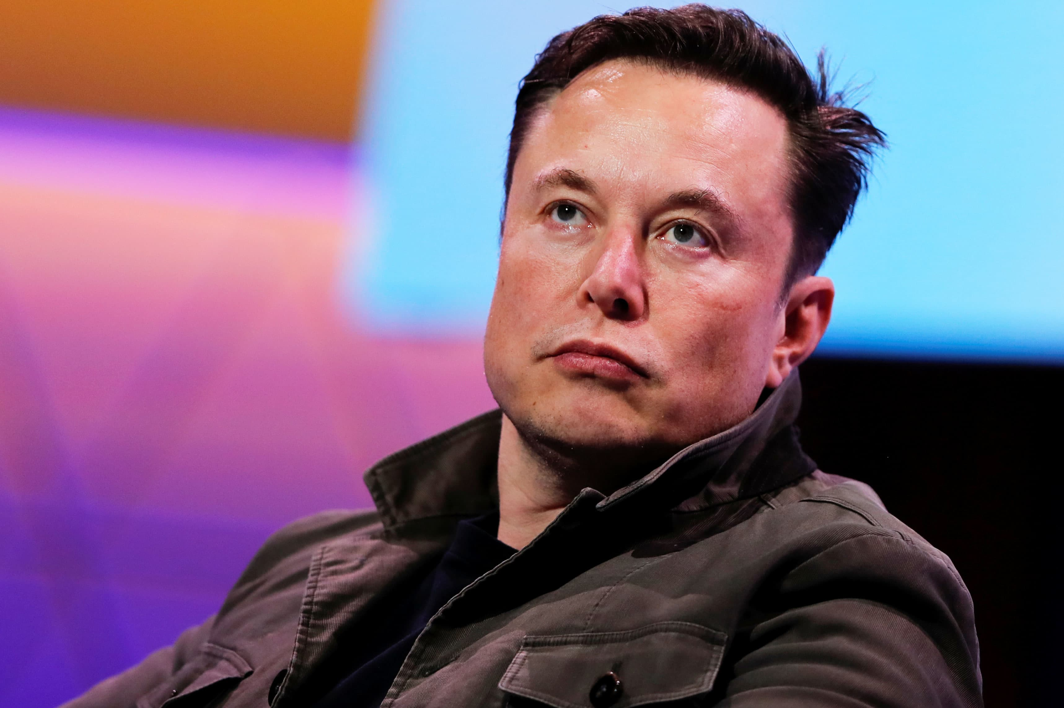
The identified leader of social Emotion Competence we choose
Elon Musk

Slide 9
The Identified leader OF social Emotion Competence Elon musk
Elon Musk care about his employees and customers, sometimes even in the midnight, he also help Tesla customers to deal with some problems (Mejia, 2017, para. 2).
Tesla manufacturing factory had high injury rates that he knows, so he sent an email to all the employees immediately (Mejia, 2017, para. 2).

Slide 10
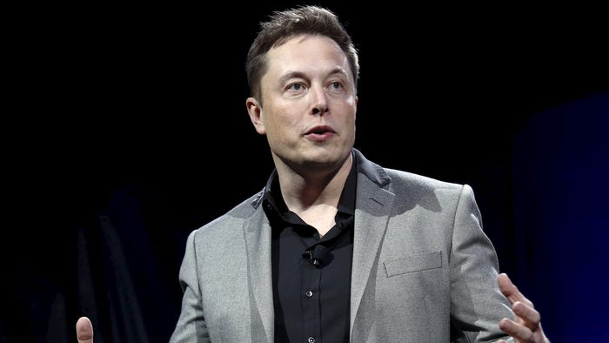
The Part of Letter Elon musk wrote to Employees
Care Employees
“No words can express how much I care about your safety and wellbeing. It breaks my heart when someone is injured building cars and trying their best to make tesla successful.
Going forward, I’ve asked that every injury be reported directly to me, without exception. I’m meeting with the safety team every week and would like to meet every injured person as soon as they are well, so that I can understand from them exactly what we need to do to make it better. I will then go down to the production line and perform the same task that they perform.
This is what all managers at tesla should do as a matter of course. At tesla, we lead from the front line, not from some safe and comfortable ivory tower. Managers must always put their team’s safety above their own.”
--- Elon Musk (Mejia, 2017, para. 2)
Experience by himself to be the company employees
Care Safety more than works

Slide 11
Why we choose elon musk?
Elon shows his high emotion skills in this case
Highly effective communication and quickly solving problem skill with others (which represent in this story)
His behaviors (which represent in his letter, he care about his employee's safety)

Slide 12
Part 2
Review one theory or model about the nature of the attribute the leader demonstrated

Slide 13
theory demonstration
Social Emotional competence
Personal competence
Emotional Awareness
Social competence
Self- management
Social awareness
(Goleman, Boyatzis & McKee, 2002)

Slide 14
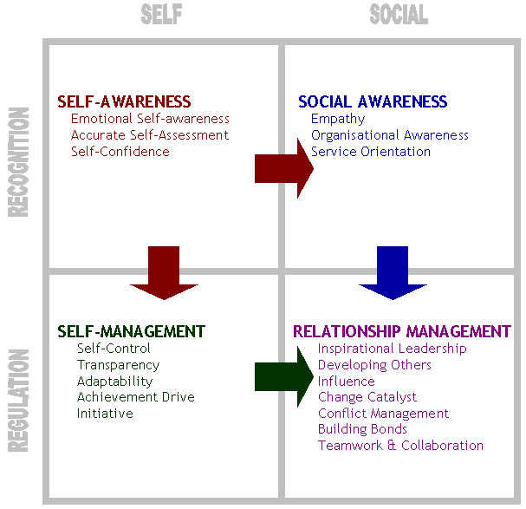
GOLEMAN'S MODEL OF EMOTIONAL INTELLIGENCE
(Goleman, 1995)

Slide 15
Personal competence
Emotional Awareness:
Emotional awareness is the ability to recognize and make sense of not just your own emotions, but also those of others.
(Sheri, 2016)

Slide 16


Illustration OF EMOTIONAL AWARENESS IN OUR DAILY LIFE
As a university student
Group projects
•Future In workplace
•How to communicate with others
•Adjust your actions based on the potential reactions of others
•As a member in Family
•Understanding parent's emotions
•How to communicate with parents
This Photo by Unknown author is licensed under CC BY-NC.

Slide 17

Why should we apply Emotional Awareness in our daily life ?
Better performance in workplace.
Build closer relationship with people.
Manage relationship between people
CAN HELP YOURSELF FEEL BETTER BY HELPING OTHER.

Slide 18
PERSONAL COMPETENCE
Self-confidence:
It means you accept and trust yourself and have a sense of control in your life. You know your strengths and weakness well and have a positive view of yourself.
(University of South Florida, n.d.)

Slide 19


Illustration OF Self-Confidence IN OUR DAILY LIFE
As a university student
Answering questions
Discussion in group projects
Future In workplace
Handling projects
Never got discouraged
This Photo by Unknown author is licensed under CC BY-NC.

Slide 20

WHY SHOULD WE APPLY Self-Confidence IN OUR DAILY LIFE ?
Increased sense of self-worth.
Less fear and anxiety.
More energy and motivation to act.
Greater success !
This Photo by Unknown author is licensed under CC BY-SA.

Slide 21

SOCIAL COMPETENCE

Slide 22

Social competence
to evaluate social situations and determine what is expected or required.
to recognize the feelings and intentions of others.
to select social behaviors that are most appropriate for that given context.

Slide 23
Social competence
Social awareness
Relationship management

Slide 24
SOCIAL AWARENESS
Empathy
Organisational awareness
Service orientation
(Transforming Education, 2020)
Notes:
EMPATHIZE WITH OTHERS FROM DIVERSE BACKGROUNDS AND CULTURES
UNDERSTAND SOCIAL AND ETHICAL NORMS FOR BEHAVIORS
RECOGNIZE FAMILY, SCHOOL, AND COMMUNITY RESOURCES AND SUPPORTS

Slide 25
ILLUSTRATION OF SOCIAL AWARENESS
IN OUR DAILY LIFE
As a university student
As a programmer

Slide 26
Benefits OF SOCIAL AWARENESS
form strong friendships and relationships.
promotes compassion and empathy when interacting with others
understand strengths and weaknesses
improves social and emotional wellbeing

Slide 27
Pros OF SOCIAL EMOTIONAL COMPETENCE
Academic success
Fewer behavioral problems
Less emotional distress
Positive social behavior

Slide 28


cons of Social Emotional competence
IT IS TOO HARD TO ACHIEVE !
This Photo by Unknown author is licensed under CC BY-NC-ND.

Slide 29
Part 3
Analyze the story of the leader with the reviewed theory or model

Slide 30
How elon achieve social emotional competence?
PERSONAL COMPETENCE
Social competence
EMOTIONAL COMPETENCE
EMOTIONAL COMPETENCE ON HIMSELF
EMOTIONAL COMPETENCE ON OTHERS
SELF-MANAGEMENT
Self-Confidence
SOCIAL AWARENESS
RELATIONSHIP MANAGEMENT

Slide 31
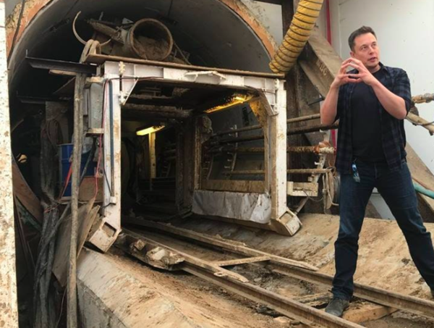
HOW ELON ACHIEVE SOCIAL EMOTIONAL COMPETENCE?
PERSONAL COMPETENCE
EMOTIONAL COMPETENCE
EMOTIONAL COMPETENCE ON HIMSELF
Elon has a Very high emotional intelligence
He encountered a lot of setbacks on the way to start a business. Yet, he overcame the stress and made the right calls of the companies.

Slide 32
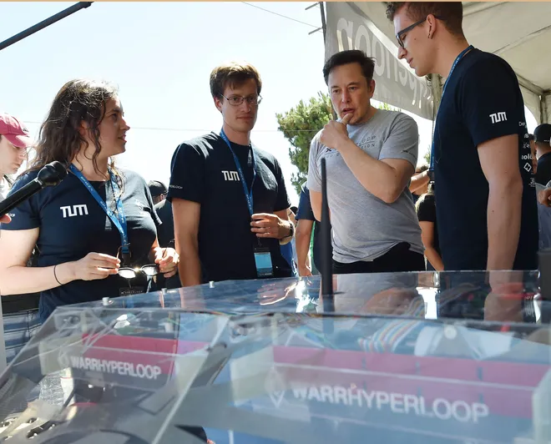
HOW ELON ACHIEVE SOCIAL EMOTIONAL COMPETENCE?
PERSONAL COMPETENCE
EMOTIONAL COMPETENCE
EMOTIONAL COMPETENCE ON others
Elon really care about his employees
He understand his employees work very hard for him.
He don’t want his employees to get hurt.
He meet the injured workers in person and meet safety team every week.
He realized the problems and make adjustment immediately.

Slide 33
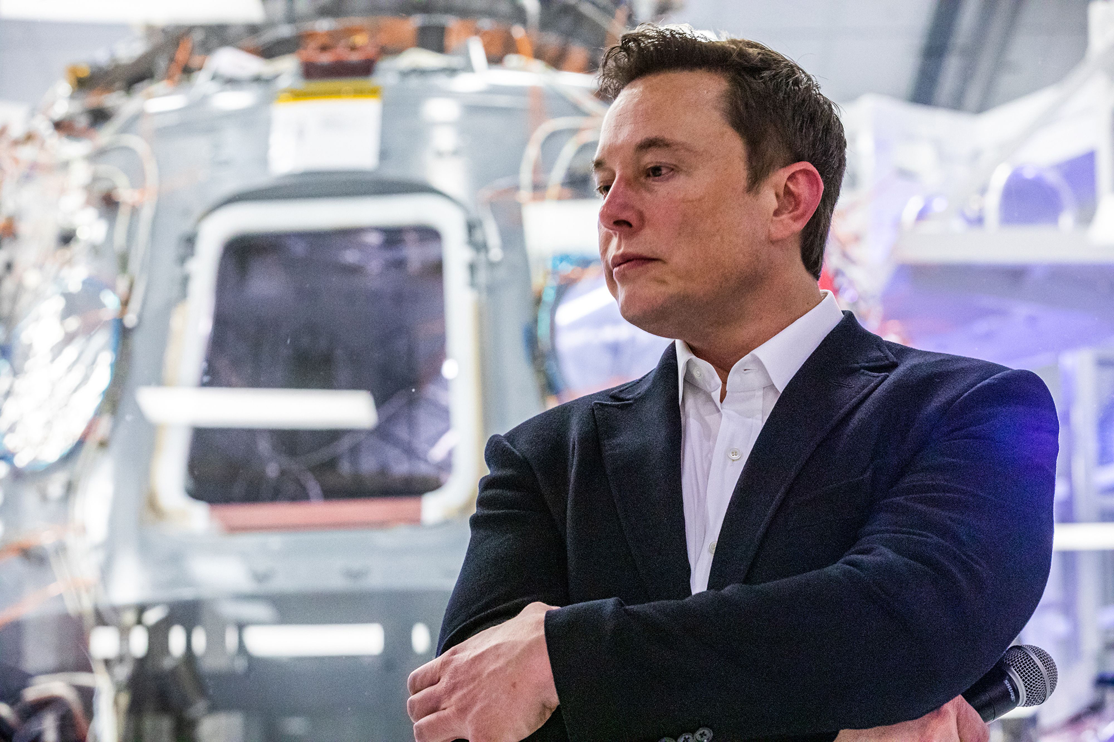
HOW ELON ACHIEVE SOCIAL EMOTIONAL COMPETENCE?
PERSONAL COMPETENCE
SELF-MANAGEMENT
ELON IS A SELF-DISCIPLINED PERSON
HE INSISTED TO READ TWO BOOKS EVERYDAY when he was young.
HE SPENDs 80-100 HOURS EVERY WEEKS ON WORKING IN TESLA AND SPACEX.
HE insistS to check emails every morning and deliver missions to underlings.

Slide 34
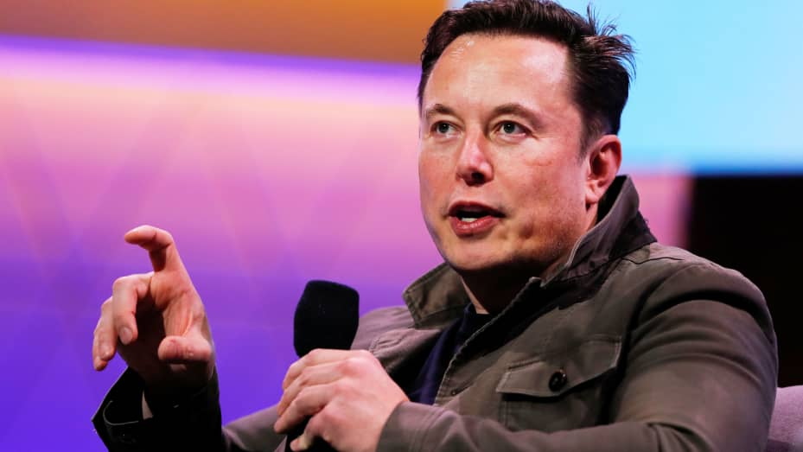
HOW ELON ACHIEVE SOCIAL EMOTIONAL COMPETENCE?
PERSONAL COMPETENCE
Self-Confidence
1. He trusts and believes himself.
Elon is a confident person; he knows that he is an expert in it, so he quitted university and invested moneys and times to start "zip 2".
Elon believed that there is nothing impossible in the world. So, he always set some challenging goals for himself and his companies in order to seeking for progressing and breakthrough.

Slide 35
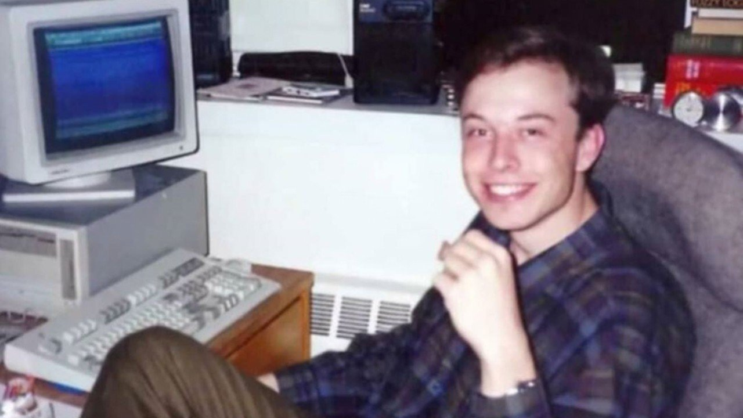
HOW ELON ACHIEVE SOCIAL EMOTIONAL COMPETENCE?
PERSONAL COMPETENCE
SELF-CONFIDENCE
2. He control his own life.
Elon was visionary when he was young, he want to be conductive to the world and unwilling to be ordinary.
When he was 18, he decided to quit university and start his own business , many people told him not to do so, but he decided to follow his heart.

Slide 36
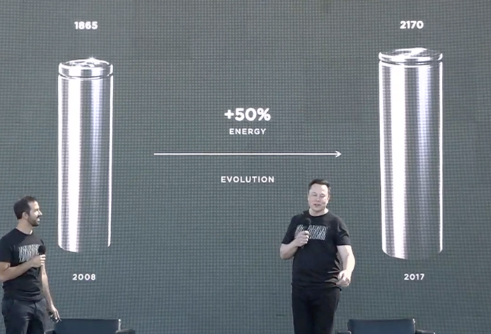
HOW ELON ACHIEVE SOCIAL EMOTIONAL COMPETENCE?
PERSONAL COMPETENCE
SELF-CONFIDENCE
3. Elon knows his own strengths and weaknesses.
Elon is a practical designer; he knows how to maximize THE strengths and minimize the cons.
When elon designed the battary for the electic car, he encountered a problem which was they couldn't design a high-capacty battary. However, they decided to bind some battary into one INSTEAD OF USE MANY FUNDS TO DESIGN ONE HIGH-CAPACTY BATTARY.

Slide 37
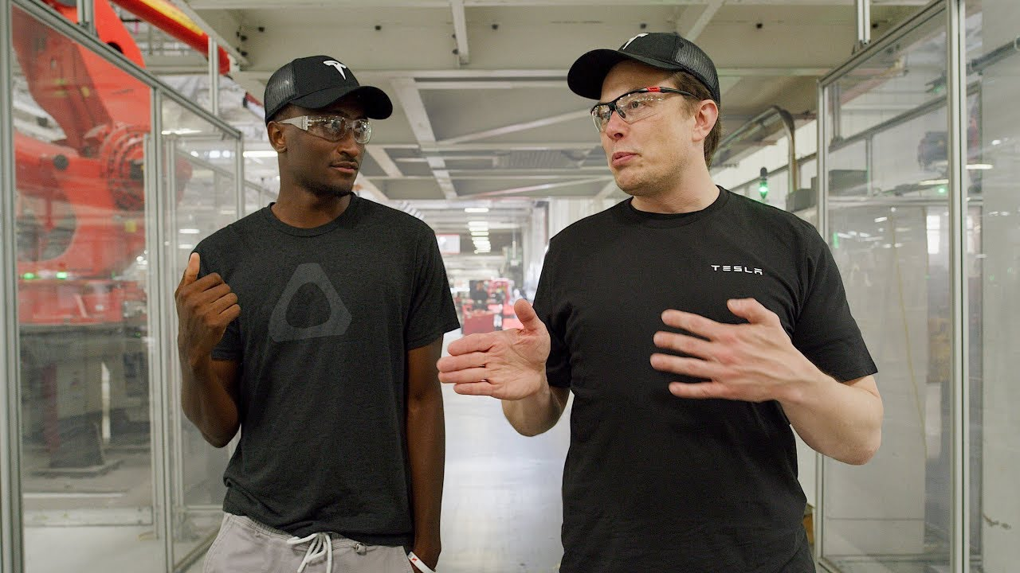
HOW ELON ACHIEVE SOCIAL EMOTIONAL COMPETENCE?
PERSONAL COMPETENCE
SELF-CONFIDENCE
4. elon always has a positive view.
When elon encountered some negative feedbacks on his productes, he always remain positive and very open to ideas. HE encourage his employees to give him more feedbacks on his products.

Slide 38
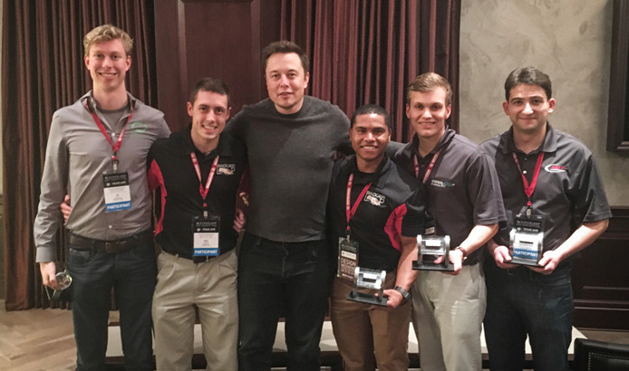
HOW ELON ACHIEVE SOCIAL EMOTIONAL COMPETENCE?
SOCIAL COMPETENCE
SOCIAL AWARENESS
Elon's companies like to recruit the elites in related industry to work for him.
He likes to hear different voices from his employees no matter good or bad one.
Elon LIKES TO ask his employees some questions when he enocunter some difficulties.

Slide 39
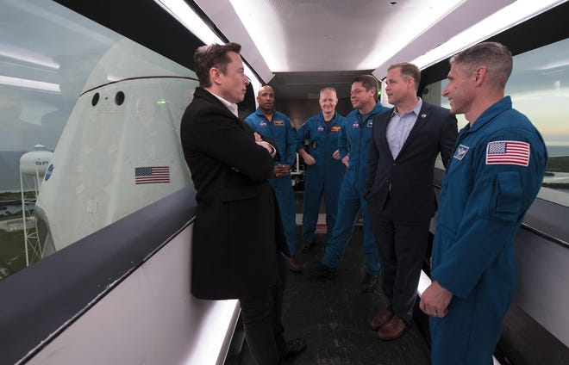
HOW ELON ACHIEVE SOCIAL EMOTIONAL COMPETENCE?
SOCIAL COMPETENCE
Relationship skills
Elon believeS that maintain a good relationship with employees is the key to success.
HE REALLY CARES ABOUT THE FEELINGS FROM HIS WORKERS, HE HAS SENSE OF EMPATHY ON THEM.
He knOwS HE CAN'T FINISH GREAT PROJECTS BY OWN, SO he needS an excellent team to turn his plans into reality.

Slide 40


My unterstanding to socail emotional competence (SeC)
Social emotional competence is an indivisible part in our lifes.
It is a class for life.
It helps us to become a whole.

Slide 41
How sec helps us in our life?
Help us to recognize ourselve
Many of you may feel lost in your life and feel that your life is planned.
SEC encourage you to chase your dream, recognize what is your strengths and weaknesses. Set up clear goals for yourself from stort terms and long terms.

Slide 42
How sec helps us in our life?
HElp us to manage ourselves from emotional and behavious
Once we encounter some setbacks in our life, we have to learn how to deal with it with a positive attitude and try not to aviod it.
Apart from staying positive , we have to stick to our dreams preseverely, don't give up easily.

Slide 43
How sec helps us in our life?
Help us to maintain good relationship with others
It is very vital to notice others' feelings no matter from school, family and workplaces. You have to be sensortive enough on others' emotion and make the most appropriate reaction in order to maintain the relationship.
"united we stand, divided we fall."
Trust the power of united!
Trust the power of cooperating with others.
Try to work with the people who share the same value and dream.

Slide 44
Part 4

Slide 45
APPLY Personal COMPETENCE INTO OUR OWN LIVES
(Enter a new environment)
Notes:
First, we will discuss how to apply the personal competence into our own lives. Imagine that we are entering a new environment.

Slide 46
GOLEMAN'S MODEL OF EI
Social Competence
Personal competence

Slide 47
APPLY PERSONAL COMPETENCE INTO OUR OWN LIVES
WE WILL BE PROVIDING 2 PRACTICAL WAYS TO ENHANCE OUR SOCIAL-EMOTIONAL COMPETENCE:
To INCREASE PERSONAL COMPETENCE (Gigi):
Control our disruptive emotions and make suitable responses
To INCREASE SOCIAL COMPETENCE (JASON):
Be proactive in improving in your social interactions
We will be providing concrete steps on how to apply these practical ways to your life

Slide 48
PERSONAL COMPETENCE
“There is perhaps no psychological skill more fundamental than resisting impulse. It is the root of all emotional self-control, since all emotions, by their very nature, lead to one or another impulse to act.” ― Daniel Goleman, Emotional Intelligence

Slide 49
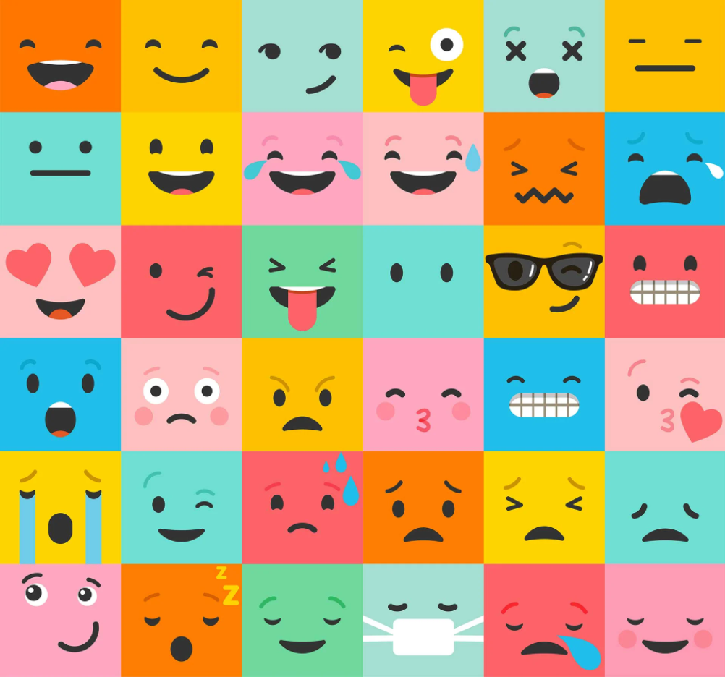
Personal Competence
Step 1: Recognize our emotions accurately
Distinguish different Emotions
Positive
Negative

Slide 50

PERSONAL COMPETENCE
Step 2: Think about the impact these emotions may have on us
Immediate effects
Distant influences
Range of impacts (people around us)

Slide 51

PERSONAL COMPETENCE
Step 3: Adjust our emotions to a state of equilibrium
Take a deep breath
Slowly
Hold it

Slide 52

PERSONAL COMPETENCE
Step 4: Imagine the different situations we might encounter
Prepare in advance
improvise calmly
Enhance flexibility

Slide 53

PERSONAL COMPETENCE
Step 5: Accept and trust yourself
Weaknesses
strengths
Encouragement
Get a foot in the door

Slide 54

PERSONAL COMPETENCE
Step 6: RECOGNIZE Others' EMOTIONS ACCURATELY
Response
Achieve the goals

Slide 55
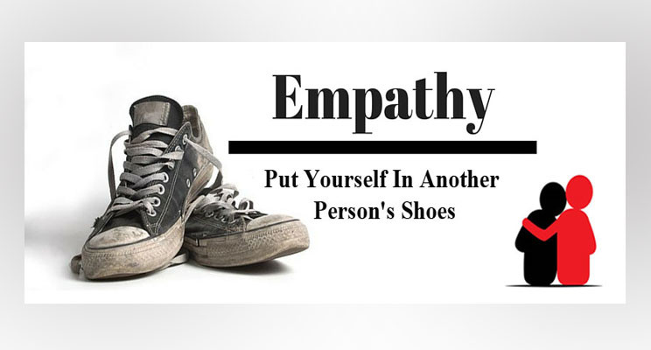
BE PROACTIVE IN IMPROVING IN YOUR SOCIAL INTERACTIONS
1. Imagine yourself in their situation, how you would react/feel to the situation/what you say
(Jeremy Sutton, Ph.D., 2021)

Slide 56
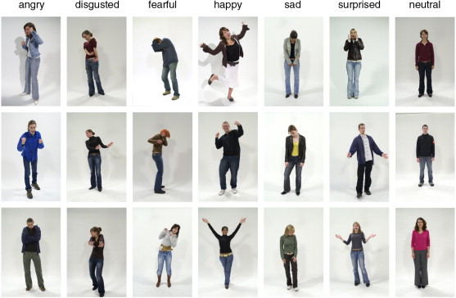
BE PROACTIVE IN IMPROVING IN YOUR SOCIAL INTERACTIONS
2. read the room, recognize the situation you are in, eg. Reading body language (Tripathy, Dr. (2018).)

Slide 57

BE PROACTIVE IN IMPROVING IN YOUR SOCIAL INTERACTIONS
3. Think carefully
How what you say might be received by the other (Tripathy, Dr. (2018))

Slide 58
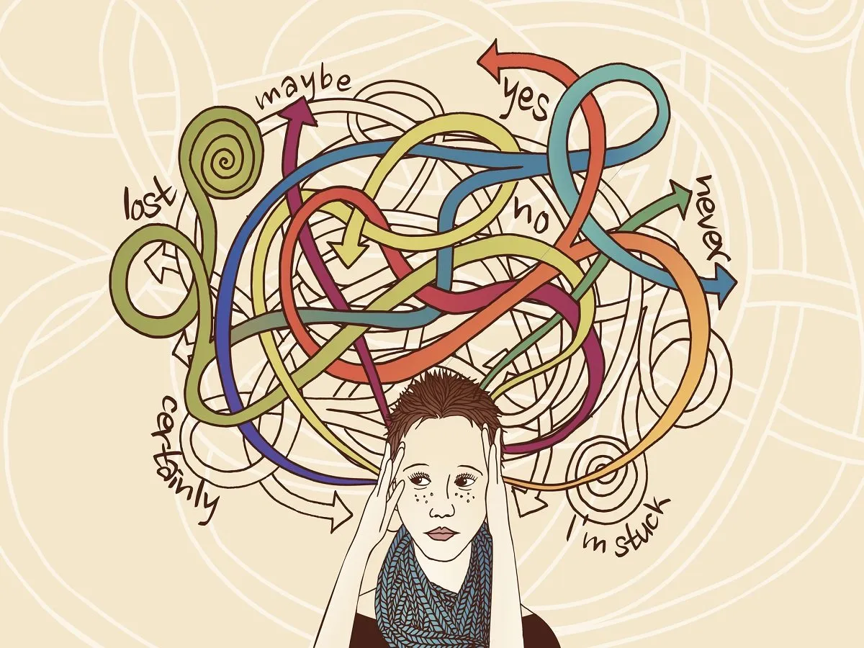

BE PROACTIVE IN IMPROVING IN YOUR SOCIAL INTERACTIONS
Though it is important to not overthink, thinking is still an important aspect in conveying yourself properly to others

Slide 59
Part 5

Slide 60
Reflections
Social-emotional competence let us have effective communication in our team meeting. Also, we used WhatsApp group and shared PPT to mark sure the quickly solving problem for our presentation. Also, when we have destructive emotions, every team member will help them make sure the feeling is right.

Slide 61
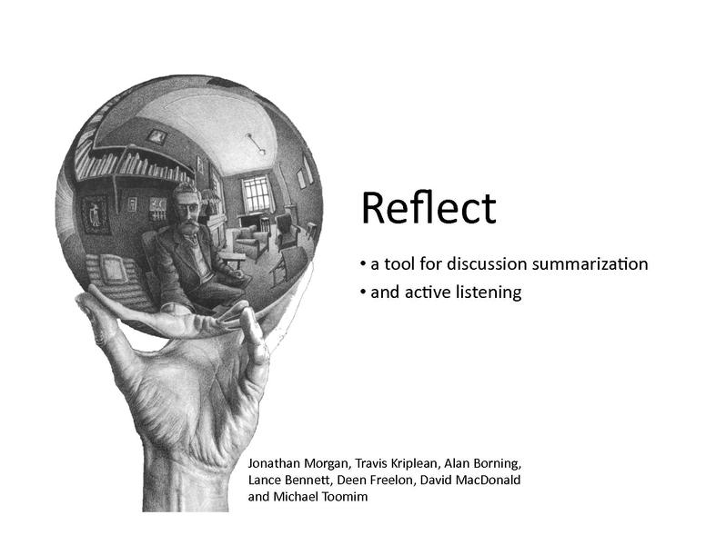
reflections
This Photo by Unknown author is licensed under CC BY-SA.

Slide 62
References
Goleman, D. (n.d.). Daniel Goleman quotes (author of Emotional Intelligence) (page 4 of 16). Goodreads. Retrieved November 9, 2021, from https://www.goodreads.com/author/quotes/829.Daniel_Goleman?pag e=4.
Goleman, D. (1995). "Emotional intelligence." New York: Bantam Books.
Junge, C., Valkenburg, P. M., Deković, M., & Branje, S. (2020). The building blocks of social competence: Contributions of the Consortium of Individual Development. In Developmental Cognitive Neuroscience (Vol. 45, p. 100861). Elsevier BV. https://doi.org/10.1016/j.dcn.2020.100861
Mejia, Z. (2017, Aug 29 ). "What you can learn from self-made billionaire Elon Musk about emotional intelligence." from https://www.cnbc.com/2017/08/29/what-you-can-learn-from-elon-musk-about-emotional-intelligence.html
Raypole, C. (2020, April 28). How to control your emotions: 11 strategies to try. Healthline. Retrieved November 9, 2021, from https://www.healthline.com/health/how-to-control-your-emotions.
Salovey, P., & Mayer, J. D. (1990). "Emotional Intelligence. In Imagination, Cognition and Personality" (Vol. 9, Issue 3, pp. 185–211). SAGE Publications. https://doi.org/10.2190/dugg-p24e-52wk-6cdg
Sheri Jacobson (2016). "personal competence" https://www.harleytherapy.co.uk/counselling/emotional-awareness.htm
Transforming Education. (2020, September). Introduction to social awareness - transforming education. Introduction-to-Social-Awareness. Retrieved November 9, 2021, from https://transformingeducation.org/wp-content/uploads/2020/09/Introduction-to-Social-Awareness.pdf.
Tripathy, Dr. (2018). "EMOTIONAL INTELLIGENCE: AN OVERVIEW." LAMBERT Academic Publishing
University of South Florida (n.d.)WHAT IS SELF-CONFIDENCE? https://www.usf.edu/student-affairs/counseling-center/top-concerns/what-is-self-confidence.aspx
Virtual Lab School. "Promoting Children's Social Skills and Emotional Competence." Promoting Children's Social Skills and Emotional Competence. from https://www.virtuallabschool.org/preschool/child-abuse-prevention/lesson-3
Zsolnai, A. (2015). Social and emotional competence. Hungarian Educational Research Journal, 5(1), 1-10, https://doi.org/10.14413/herj.2015.01.01

Slide 63
Photo Refence
Baum, D. (2021). How Emotion Influences Buying Behavior. photograph. Retrieved from https://www.impactplus.com/blog/emotion-influence-buying-behavior.
Elon Musk tweeted that he will abide by the results of the poll, whichever way it goes. (2021). Elon Musk Leaves Fate Of His $21 Billion Tesla Stock On Twitter Poll. photograph. Retrieved from https://www.ndtv.com/world-news/elon-musk-leaves-fate-of-10-of-his-tesla-stock-worth-21-billion-on-twitter-poll-2601604.
Fallon, P. (n.d.). Tesla Motors Ceo Elon Musk. Elon Musk Says Tesla Vehicles Will Drive Themselves in Two Years. photograph. Retrieved from https://fortune.com/2015/12/21/elon-musk-interview/.

